Slide 1
Hands Up America
Christian
Holland
Jackie
Liu

Slide 2
Task
Analyze 2016 IRS Data
Assess how state data compares to national data
Provide insights into goal of servicing low and elderly taxpayers
Assumptions
- elderly classified as over 60 years old
- all numbers in thousands of dollars
per Volunteer Income Tax Assistance (VITA) program, low income classified as $54,000 or less, however data collected $50K benchmark
data includes all 50 states plus District of Columbia
data includes Other Areas – Army Post Office, US citizens abroad, Puerto Rican residents

Slide 3
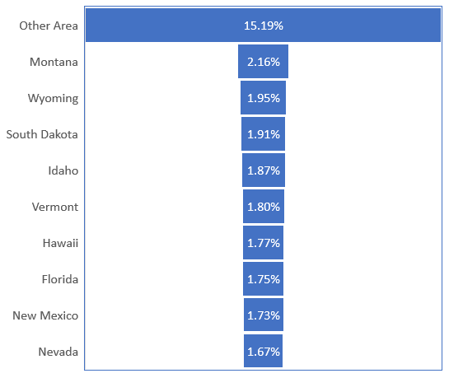
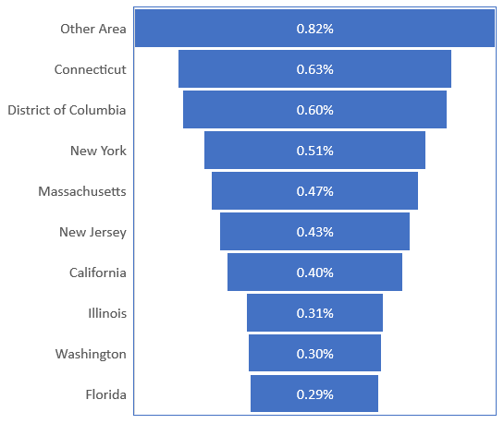
Percentage of Returns by State
Less than $1
More than $1M

Slide 4
Percentage of Returns by State

Slide 5
Percentage Elderly Returns – Top 10 States
Percentage

Slide 6

Elderly vs. Low Income
Elderly Returns – 23.81% National Average
Low Income Elderly Returns – 52.02% Elderly Returns
29 states above National Average
35 states above National Average

Slide 7
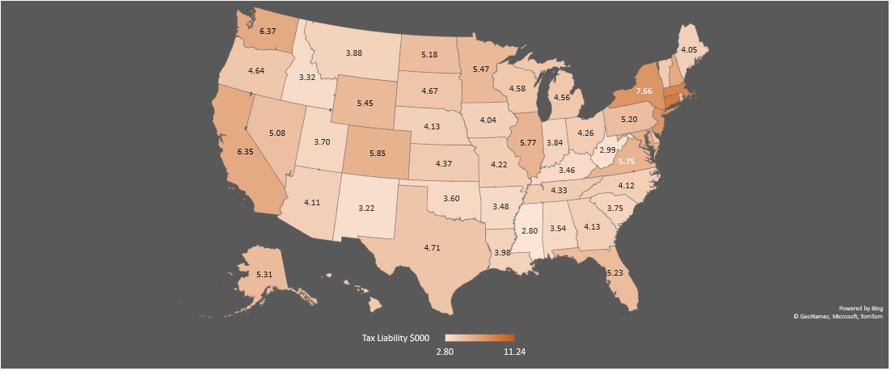
Tax Liability Per Person, by State

Slide 8
Insights
Elderly returns tend to show more than $50,000 adjusted gross income (AGI) for states
Over 60% of state total income is generated from active vs. passive sources
Most returns for HUA population fall in <$1000 tax bracket
Critique need for funding assistance towards elderly population with high income thresholds

Slide 9
Insights
Use Vermont, Montana and Maine as model to roll out programming for elderly assistance, given higher percentage of elderly returns
State data for number of elderly returns mimics national percentage of 23.81 with state median of 24.6
District of Columbia has lowest percentage of elderly returns – 17%

